Slide 1
BRITISH AIRWAYS CUSTOMER REVIEW ANALYSES
BY
TOLU AJAYI
2023

Slide 2
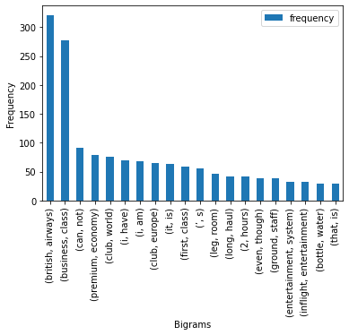
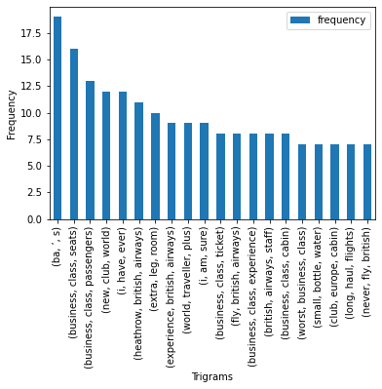
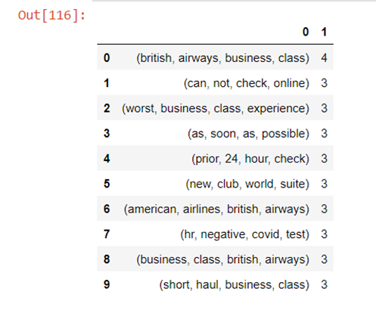
EXPLORATORY DATA ANALYSIS
Ngrams were used to investigate the most common phrases within the reviews to conclude on the most prominent issues raised by customers. From the visualised data below, we can see that customers;
Have issues with the business class experience
Have issues with online check-in
Have a need for faster processes
Would appreciate more leg room

Slide 3
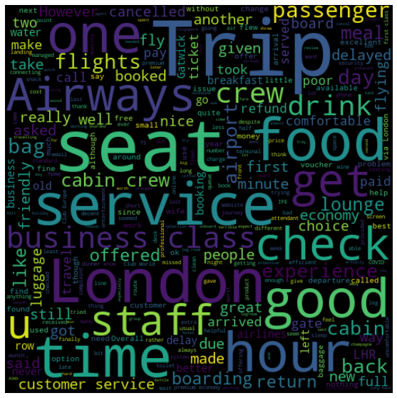
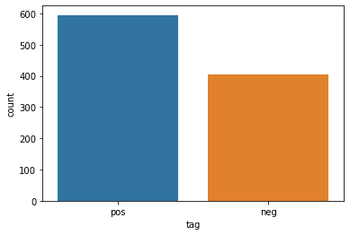
Next, a sentiment analysis was carried out on all the reviews to determine positively and negatively themed entries.
It was found that there were 25% more positive than negative comments.
Finally, the word cloud for the data was generated.

